Slide 1
Fault testing of Reversible circuit
Submitted by
Sudeshna Haldar Akash Patra
Roll No:91/MCA/190019 Roll No: 91/MCA/190015
Reg No: D01-1211-0048-19 Reg No: 432-1121-0869-15
MCA 6th SEMESETER
Guided By
Asst. Prof. Joyati Mondal

Slide 2
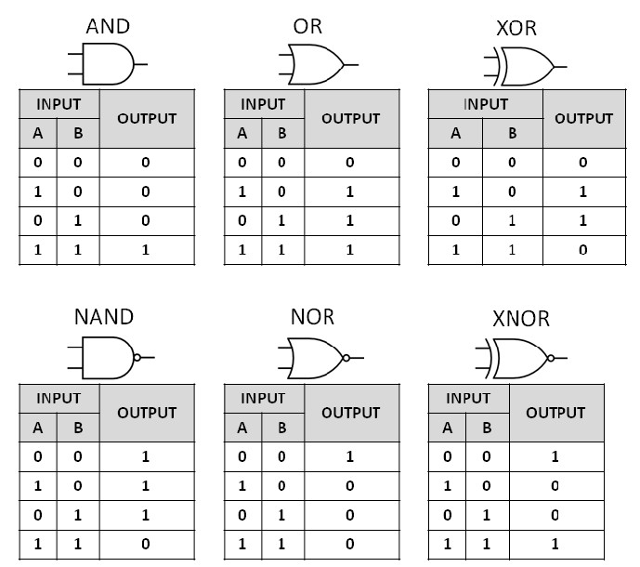
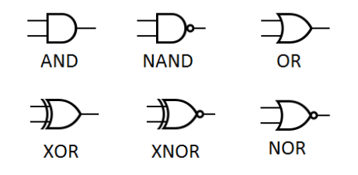
REVERSIBLE COMPUTATION
Number of input is more than the number of output
Once output is reached, inputs can not be reconstructed using the output only this is called information loss.

Slide 3
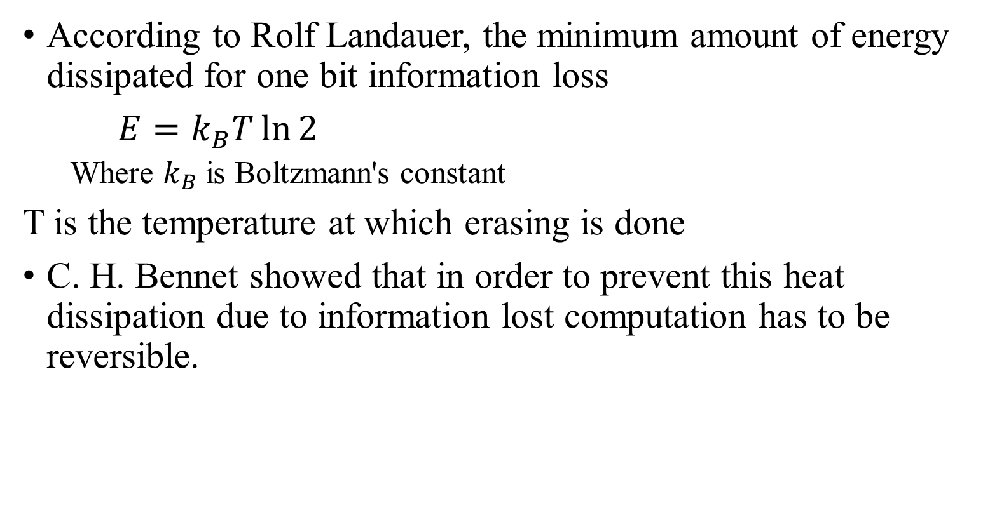
REVERSIBLE COMPUTATION
According to Rolf Landauer, the minimum amount of energy dissipated for one bit information loss
$E=k_{B}T\ln{2}$
Where $k_{B}$ is Boltzmann's constant
T is the temperature at which erasing is done
C. H. Bennet showed that in order to prevent this heat dissipation due to information lost computation has to be reversible.

Slide 4

REVERSIBLE FUNCTION
A logic function $f(x_{1},x_{2}, …, x_{n})$ of n Boolean variables is called a reversible function if
No of input = no of output
Every input has unique output(bijective function)
Not Reversible Function Reversible Function
INPUT |  | OUTPUT
A | B | C | D
0 | 0 | 1 | 0
0 | 1 | 1 | 1
1 | 0 | 1 | 0
1 | 1 | 0 | 0
INPUT |  | OUTPUT
A | B | C | D
0 | 0 | 1 | 0
0 | 1 | 1 | 1
1 | 0 | 0 | 1
1 | 1 | 0 | 0

Slide 5
APPLICATION OF REVERSIBLE COMPUTING
Low Power Design
Quantum Computing
Cryptography

Slide 6
REVERSIBLE GATES
Reversible gate implements the basic reversible function
The commonly used reversible gates can be
Not gate
Feynman Gate
Toffoli Gate
Fredkin Gate
Multiple Control Toffoli (MCT) gate
Multiple Control Fredkin (MCF) gate
Peres gate

Slide 7

NOT GATE
A NOT gate performs logical negation on its input,i,.e, if the input is 0, then the output will be 1. Similarly, a 1 input results in a 0 output.
Truth Table
INPUT | OUTPUT
0 | 1
1 | 0
Block Diagram

Slide 8
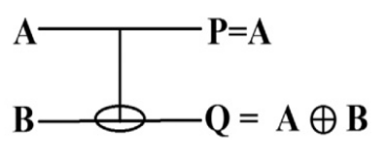
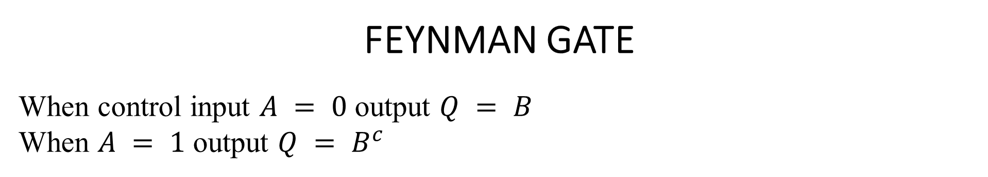
FEYNMAN GATE
When control input $A = 0$ output $Q = B$
When $A = 1$ output $Q = B^{c}$
INPUT | OUTPUT
A | B | P | Q
0 | 0 | 0 | 0
0 | 1 | 0 | 1
1 | 0 | 1 | 1
1 | 1 | 1 | 0

Slide 9
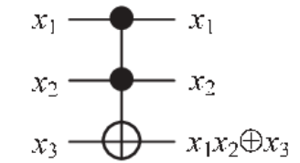
TOFFOLI GATE
A Toffoli Gate has minimum two control. When all control inputs are 1 the target input is complemented to produce output.
INPUT | OUTPUT
X1 | X2 | X3 | P | Q | R
0 | 0 | 0 | 0 | 0 | 0
0 | 0 | 1 | 0 | 0 | 1
0 | 1 | 0 | 0 | 1 | 0
0 | 1 | 1 | 0 | 1 | 1
1 | 0 | 0 | 1 | 0 | 0
1 | 0 | 1 | 1 | 0 | 1
1 | 1 | 0 | 1 | 1 | 1
1 | 1 | 1 | 1 | 1 | 0

Slide 10
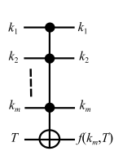

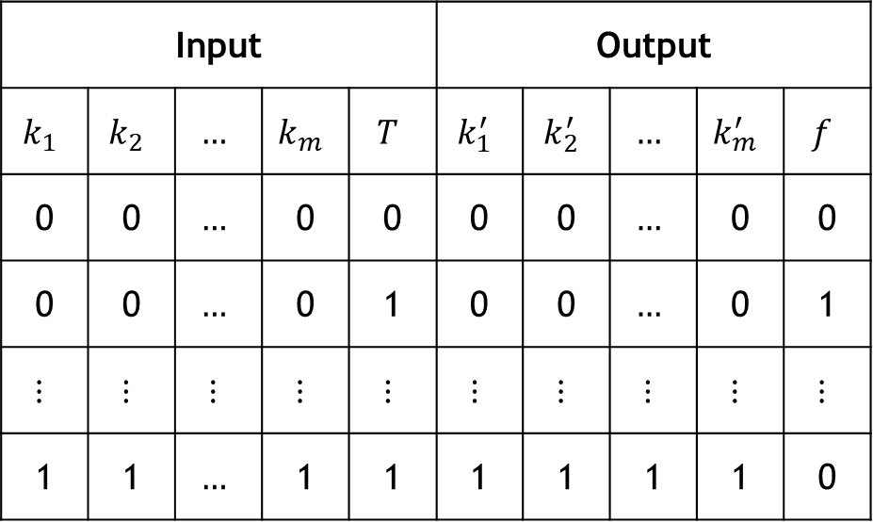
MULTIPLE CONTROL TOFFOLI (MCT) GATE
Generalized version of Toffoli gate
$f\left(k_{m}, T\right)=k_{1}.k_{2}…k_{m}⊕T$
Input |  |  |  |  | Output
$$k_{1}$$ | $$k_{2}$$ | $$…$$ | $$k_{m}$$ | $$T$$ | $$k_{1}^{′}$$ | $$k_{2}^{′}$$ | $$…$$ | $$k_{m}^{′}$$ | $$f$$
0 | 0 | $$…$$ | 0 | 0 | 0 | 0 | $$…$$ | 0 | 0
0 | 0 | $$…$$ | 0 | 1 | 0 | 0 | $$…$$ | 0 | 1
$$⋮$$ | $$⋮$$ | $$⋮$$ | $$⋮$$ | $$⋮$$ | $$⋮$$ | $$⋮$$ | $$⋮$$ | $$⋮$$ | $$⋮$$
1 | 1 | $$…$$ | 1 | 1 | 1 | 1 | 1 | 1 | 0
Output is inverted when all the inputs are 1

Slide 11
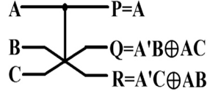
FREDKIN GATE
When the control input is 1 the target input (B and C in the diagram) gate swapped.
Input |  |  | Output
A | B | C | P | Q | R
0 | 0 | 0 | 0 | 0 | 0
0 | 0 | 1 | 0 | 0 | 1
0 | 1 | 0 | 0 | 1 | 0
0 | 1 | 1 | 0 | 1 | 1
1 | 0 | 0 | 1 | 0 | 0
1 | 0 | 1 | 1 | 1 | 0
1 | 1 | 0 | 1 | 0 | 1
1 | 1 | 1 | 1 | 1 | 1

Slide 12
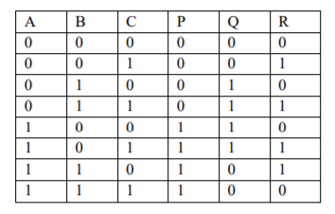
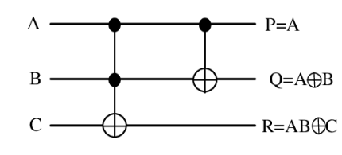
PERES GATE
When input to A is 1, input to B gets complemented
when input to A and B are 1, input to C gets complemented

Slide 13
FAULT AND FAULT MODEL
A fault is a logical model of a physical disturbance, which changes the (Boolean) function of the circuit.
A fault model depicts the category of fault occurrence in a circuit and guides in identifying the target for testing.

Slide 14
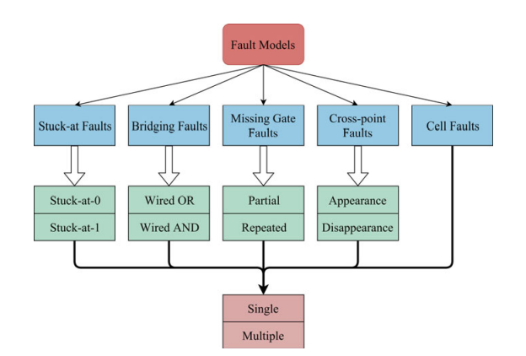
FAULT MODEL FOR REVERSIBLE CIRCUIT
The following diagram shows the different fault model which can be applied to reversible circuit:

Slide 15
MISSING GATE FAULT MODEL
Under Missing gate fault model there are four different types of fault:
a) Single Missing Gate Fault.
b) Multiple Missing Gate Fault
c) Partial Missing Gate Fault
d) Repeated Gate Fault

Slide 16
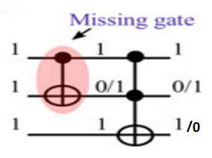
SINGLE MISSING GATE FAULT (SMGF)
SMGF corresponds to the case when one gate completely disappears from the circuit.
If a circuit has N gates, then the total no. of SMGF can occur in the circuit is N.
SMGF is detected by a vector which produces 1 at all control of the Missing gate.

Slide 17
PARTIAL MISSING GATE FAULT
A partial missing-gate fault (PMGF) corresponds to removing m out of the k control inputs of a gate, thus transforming it into a (k – m)-MCT gate.
A Partial Missing Gate Fault is detected by a vector which produces 0 in at least one of the missing control and 1 at all other control.

Slide 18
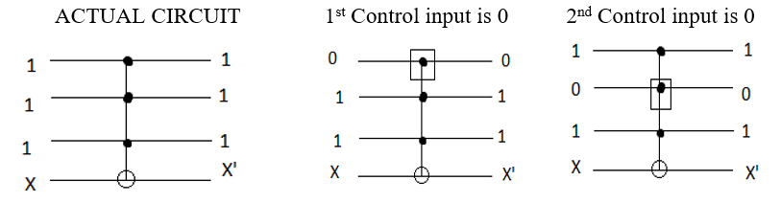
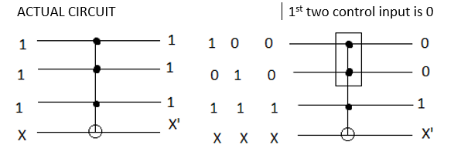
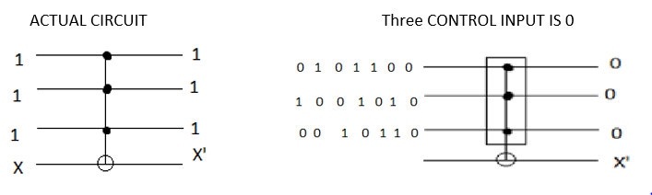
PARTIAL MISSING GATE FAULT
1st Order PMGF
2nd Order PMGF
3rd Order PMGF
AA
T
A set of vector which detects all 1st order PMGF can also detect other higher order PMGF.

Slide 19
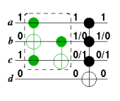
MULTIPLE MISSING GATE FAULT
Multiple missing gate fault (MMGF) is the disappearance of two or more successive gates.
In a circuit with N gates there are N(N-1)/2 MMGF fault.

Slide 20
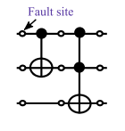
STUCK-AT FAULT
When any wire in a circuit get settled on a single logic bits 0 or 1 are termed as stuck-at-0 (S-a-0) or stuck-at-1 (S-a-1) faults respectively.
In order to test Stuck-at-0 fault at any point of the circuit we have to give 1 at that input.
Similarly, to test Stuck-at-1 fault at any point of the circuit we have to give 0 at that input.
0
1
Stuck-at 0 fault
Stuck-at 1 fault

Slide 21
BLACK BOX MODEL
Overall view of the tool we are implementing
Tool
Circuit
Test set can detect all the
Faults or not
Test set
Fault Model

Slide 22
ACTIVITY DIAGRAM
Ask user to choose a Fault Model
Ask user for a Circuit
Ask user for a Test set
Validate the data
Validate the data
Valid ?
Valid ?
No
No
Yes
Yes
A
B
C

Slide 23
A
B
C
ACTIVITY DIAGRAM CONT…
Create the circuit object using the data
Create the test set object using the data
Fault Model
Initialize data structure for storing PMGF result
Stuck-at Fault
Missing Gate Fault
Get the next test vector from the test set in MGF fault
Create MGF object with provided circuit and test set
Load it to the circuit as input
Initialize data structure for storing SMGF result
D
E

Slide 24
D
E
Propagate the input through the entire circuit (All the gate)
ACTIVITY DIAGRAM CONT…
Store all the intermediate gate results
Analyse SMGF result and create statement
Check test for SMGF Fault
Check test for PMGF Fault
Analyse PMGF result and append statement
Update SMGF result data structure
Update PMGF result data structure
Show the statement to the user as output of the testing
All test vector traversed ?
No
Yes

Slide 25
CIRCUIT IMPLEMENTATION
Gate 0
Gate 1
Gate 2
Gate 3
Input Line 0
Input Line 1
Gate Controls
Input Line 2
Input Buffer
Input Line 3
Output Buffer
Input Line 0
1
0
1
0
Input Line 1
1
1
2
0
Input Line 2
1
2
1
0
Input Line 3
2
1
0
2
Gate 0
Gate 1
Gate 2
Gate 3

Slide 26
TEST SET IMPLEMENTATION
Possible values – 0 and 1
Row represents Input line
Column represents Test Vector
Number of input lines in the test set should be equal to the number of input lines of the circuit in order to test the circuit.
1
1
1
1
0
1
Input Lines
0
1
1
1
1
1
Test Vectors

Slide 27
LOADING A TEST VECTOR
1
1
0
1
Coping a test vector to the input buffer of the first gate of the circuit so that it can be propagated through the circuit for the testing.
1
1
0
1
0
1
1
1
2
0
First Gate
Last Gate
0
1
2
1
0
1
2
1
0
2

Slide 28
PROPAGATION
1
1
0
1
1
1
1
1
1
0
1
1
1
1
0
1
1
0
1
0
Input will be processed by each gate producing output which in turn will act as the input of the succeeding gate.
1
1
1
1
0
1
1
1
1
1
0
1
1
1
1
1
1
1
1
2
0
0
0
0
0
1
0
0
2
1
1
1
1
1
0
1
1
2
1
1
1
1
1
0
1
1
2
0

Slide 29
TESTING OF SMGF
1
1
1
1
0
1
0
1
1
1
1
1
Circuit
Test Set
Represents Gate
False
False
False
False
False
False
False
False
Represents Test Vector
False
False
False
False
SMGF Result (Initially)

Slide 30
TEST RESULT FOR FIRST TEST VECTOR
Load Test Vector 0
Propagate through the circuit
1
1
1
1
0
1
1
1
1
1
0
1
1
1
1
1
1
1
1
2
0
0
0
0
0
1
0
0
2
1
1
1
1
1
0
1
1
2
1
1
1
1
1
0
1
1
2
0
False
True
True
True
False
False
False
False
SMGF Result
False
False
False
False

Slide 31
ANALYSIS
Gate
T.V.
0
1
2
3
0
False
True
True
True
Passed because it has tested at least one gate
1
False
False
True
True
Passed because it has tested at least one gate
2
True
False
True
True
Passed because it has tested at least one gate
Tested
Tested
Tested
Tested
AND
Circuit Tested

Slide 32
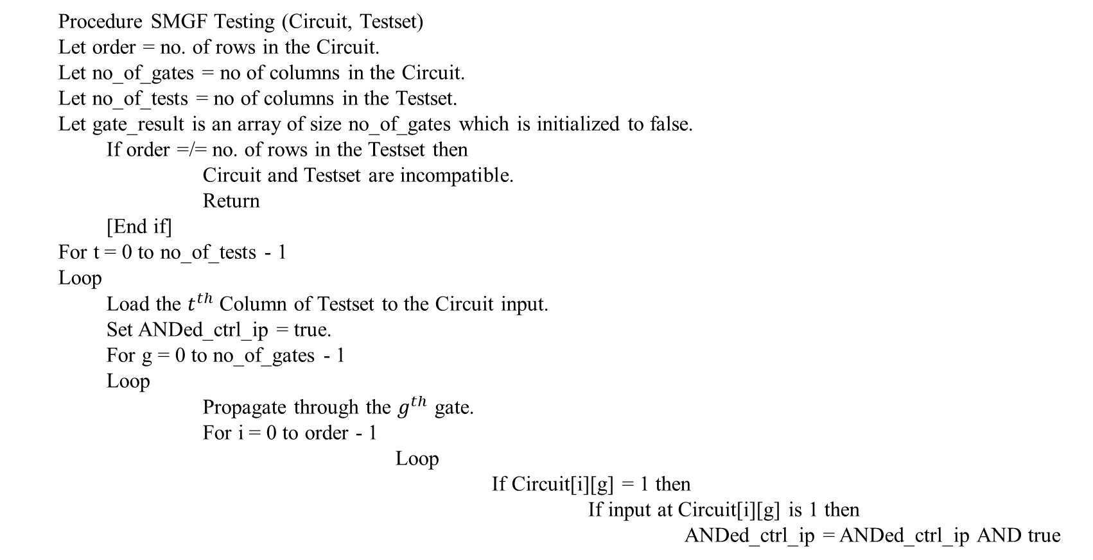
ALGORITHM FOR SMGF TESTING
Procedure SMGF Testing (Circuit, Testset)
Let order = no. of rows in the Circuit.
Let no_of_gates = no of columns in the Circuit.
Let no_of_tests = no of columns in the Testset.
Let gate_result is an array of size no_of_gates which is initialized to false.
If order =/= no. of rows in the Testset then
Circuit and Testset are incompatible.
Return
[End if]
For t = 0 to no_of_tests - 1
Loop
Load the $t^{th}$ Column of Testset to the Circuit input.
Set ANDed_ctrl_ip = true.
For g = 0 to no_of_gates - 1
Loop
Propagate through the $g^{th}$ gate.
For i = 0 to order - 1
Loop
If Circuit[i][g] = 1 then
If input at Circuit[i][g] is 1 then
ANDed_ctrl_ip = ANDed_ctrl_ip AND true

Slide 33
Else
ANDed_ctrl_ip = ANDed_ctrl_ip AND false
[End if]
[End if]
[End loop]
If ANDed_ctrl_ip = true then
gate_result[g] = true
[End if]
[End loop]
[End loop]
Set result = true
For r = 0 to no_of_gates
Loop
result = result AND gate_result[r]
End loop
If result = true then
Display Testset passed
Else
Display Testset failed
[End if]
Return

Slide 34
TESTING FOR PMGF
0 :
Parent Node Pointer
1 :
0
Child Map
2 :
3 :
Data
Parent Node Pointer : Holds the reference to the parent node.
Data : Integer number representing a certain information.
Child map : Key-value pair to hold references of child nodes.
Keys should be unique.
Node

Slide 35
TESTING FOR PMGF
0
0
0 :
0
1 :
1
2 :
: 0
2
1
: 1
0
Circuit
: 2
0 :
1
1 :
1 :
0
1
2
2 :
3 :
3
1
1
1
3 :
1
0
1
0
0 :
1
2
PMGF Result (Initially)
Will be used to store the results of PMGF testing.
0
1
2 :
2
1
1
1
3
-1 :
-1
Test Set

Slide 36
TEST RESULT FOR FIRST TEST VECTOR
Load Test Vector 0
Propagate through the circuit
1
1
1
1
0
1
1
1
1
1
0
1
1
1
1
1
1
1
1
2
0
0
0
0
0
1
0
0
2
1
1
1
1
1
0
1
1
2
1
1
1
1
1
0
1
1
2
0
Gate 0
Gate 1
Gate 2
Gate 3

Slide 37
TEST RESULT FOR FIRST TEST VECTOR CONT…
0
0 :
0
1 :
1
: 0
2 :
0
2
0 :
: 3
0 :
1
: 0
1 :
1 :
0
1
1
: 1
0
2 :
3 :
3
3 :
: 2
0
0 :
2
2
2 :
2
3
-1 :
-1
0 :

Slide 38
TEST RESULT AFTER PROPAGATING ALL TEST VECTORS
0
0 :
0
1 :
1
1 :
: 0
2 :
0
2
0 :
: 3
0 :
1
1 :
: 0
: 0
1 :
1 :
0
1
: 1
1
: 1
0
2 :
3 :
3
2 :
3 :
: 3
: 2
0
: 1
0 :
2
2
: 3
2 :
2
3
-1 :
0 :
-1
1 :
2 :

Slide 39
ANALYSIS
Gate 0 – Control 2 is tested by Test vector 0
Test vector 2 tests Gate 1 – Control 3
0
0 :
0
1 :
1
1 :
2 :
: 0
0
2
0 :
: 3
0 :
1
1 :
: 0
: 0
1 :
1 :
0
1
3 :
: 1
1
: 1
0
2 :
3
2 :
3 :
: 3
: 2
0 :
0
: 1
2
2
Circuit Not Tested
Gate 0 – Control 0 : Not tested
Gate 2 – Control 0 : Not tested
Gate 2 – Control 2 : Not tested
2 :
: 3
2
3
-1 :
0 :
-1
1 :
2 :

Slide 40
ALGORITHM FOR PMGF TESTING
Procedure PMGF_test (circuit_root, test set_root, circuit, test set)
Let no_of_gates = Number of gates in circuit
Let no_of_tests = Number of test vectors in a test set
Let order = Number of input lines in circuit
If order ≠ Number of input lines in test set then
Display “Circuit and test set are incompatible”
Return
[End if]
For t=0 to (no_of_tests – 1)
Loop
Set test_ptr = test set_root.child(t) //Child(t) fetches the child node with value t.
Get tth test vector from test set and store it in tVec.
Load tVec to the input of circuit.
Circuit.propagate()

Slide 41
ALGORITHM FOR PMGF TESTING
For g = 0 to (no_of_gates – 1)
Loop
Set candidate_ctrl = -1 // For the first control input of the gate which has input binary 0
Set rest_ctrl = true // For computing the value of the control input.
Set gate_ptr = circuit_root.child(g)
Get 9th gate from circuit and store it in current_gate
For p = 0 to (order – 1)
Loop
If p^{th} line of current gate is CONTROL INPUT then
If input 0 to p^{th} line of current gate is binary 0 then
If candidate_ctrl = -1 then
candidate _ctrl = p
Else
Rest_ctrl = (rest_ctrl AND false)
[End If]
Else
rest_ctrl = (rest_ctrl AND true)
[End If]
[End If]
[End Loop]
If rest_ctrl = true then
Set control_ptr = gate_ptr.child (candidate_ctrl)
Link control_ptr and test_ptr
[End If]
[End Loop]
[End Loop]
Return

Slide 42
FUTURE WORK
So far, our tool can detect SMGF and PMGF fault.
Our aim will be to add MMGF (Multiple Missing Gate Fault) and RGF (Repeated Gate Fault) in our tool.
We are also trying to add other different fault models.
Not just that we are also trying to make our user interface more attractive and interactable.
We are also tying to create a repository for storing the inputs given by user for latter use.

Slide 43
CONCLUSION
We have tried to build a tool which can be used by researchers working in testing of reversible circuit.
Currently we implemented only stuck-at fault model and missing gate fault model.
This tool has a Graphic User Interface. It will take a Circuit, a Fault Model and a Test set as input.
The program running in the back-end will generate all possible faults in the Circuit and verify whether the test set will be able to detect them or not.

Slide 44
REFERENCES
R. Landauer, “Irreversibility and heat generation in the computing process,” IBM Research and Development, vol. 5, pp. 183-191, 1961.
M. A. Nielsen and I. L. Chuang, Quantum Computation and Quantum Information. New York: Cambridge Univ. Press, 2000.
K. N. Patel, J. P. Hayes, and I. L. Markov, “Fault testing for reversible circuits,” VTS, pp. 410-416, 2003.
J.-S. Chang and C.-S. Lin, “Test set compaction for combinational circuits,” IEEE Trans. ComputerAided Design, vol. 14, pp. 1370–1378, Nov. 1995
J.-S. Chang and C.-S. Lin, “Test set compaction for combinational circuits,” IEEE Trans. ComputerAided Design, vol. 14, pp. 1370–1378, Nov. 1995
D. P. Vasudevan, P. K. Lala and J. P. Parkerson, “A novel approach for on-line testable reversible logic circuit design,” ATS 2004, pp. 325-330.

